Slide 1

Shiny App for Percentile of Blood Pressure in Children and Adolescents Based on CDC and JNC7 Parameters
May 14, 2019
Jun Pan

Slide 2


It is hard to remember kid’s blood pressure percentile
DOB (Age): 04/16/2014
Gender: Female
Height: 114cm (%?)
Systolic BP: 100 (%?)
Diastolic BP: 60 (%?)
So we build an shiny app using parameters provided by CDC and JNC7 to calculate the kids blood pressure and height percentile by inputting DOB, Gender, Height, Systolic BP and Diastolic BP

Slide 3
Activate Shiny App
Working Directory
“app.R” includes “ui” and “server”. “ui” defines the dashboard of the app. “server” renders information showing on the dash board such as plot of centiles, summary information etc.
“cent.R” and “bp.R” are used to calculate percentiles and generate percentile plots by using the parameters from CDC and JNC7.
runapp
about_app.html
app.R
bp.R
cent.R
datasets
CDC_parameters.csv
JNC7_parameters.csv

Slide 4
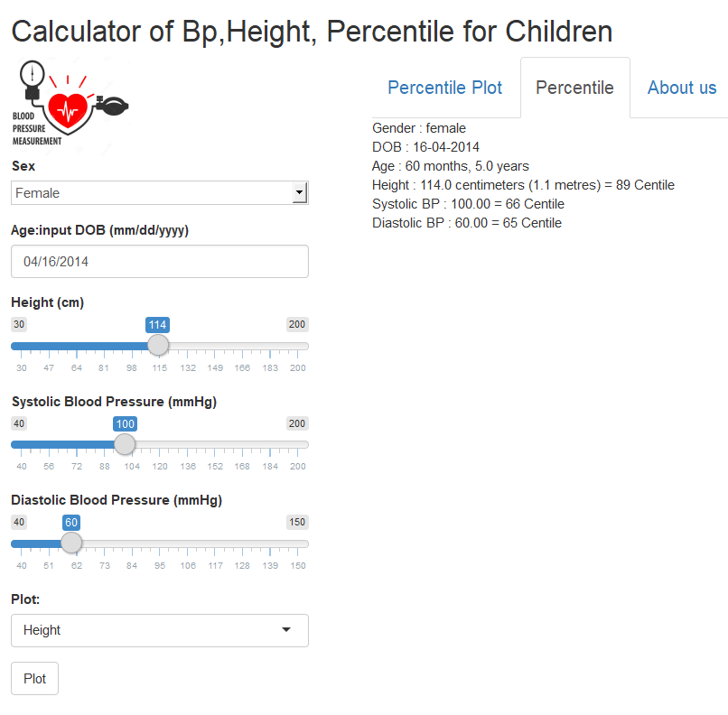
Dashboard of Shiny App
Plots will be on the next 3 slides
Select button
for male,
female
Input DOB and calculate age
Slide buttons
for Height,
Systolic bp, Daistolic bp
Select botton for making plot for height,
Systolic bp,
Diastolic bp
action button
for making
plot

Slide 5
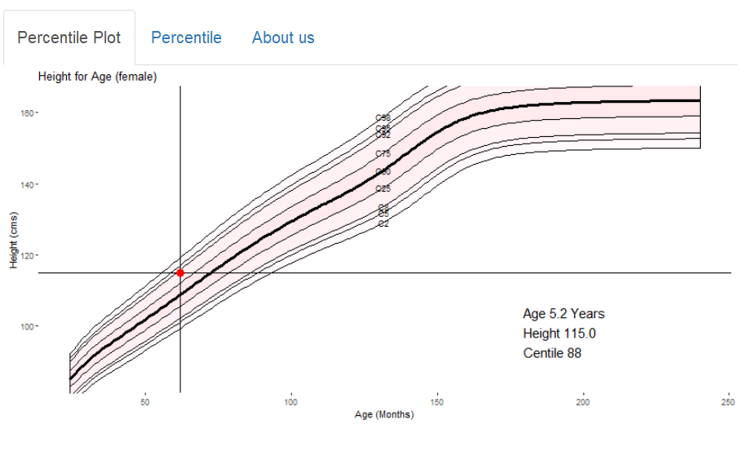
Height(cm)
For girl, the plot turns to pink. If it is boy, the plot turns to blue. After we input female, DOB:03/15/2014, height of 115cm, Bp 98/55. We start to get centiles using this app. Firstly, we select height . Then, push the action button. The plot pops up like this. There is a cross on the plot indicate age (vertically) and centile of height (88%)

Slide 6
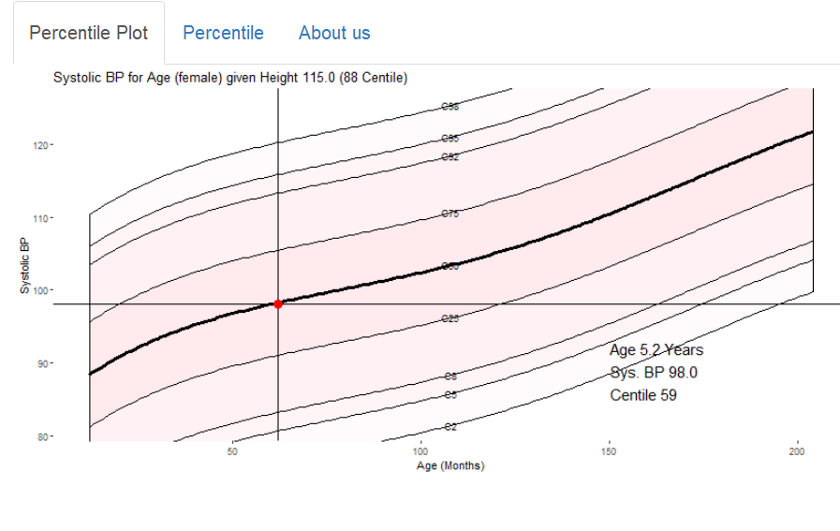
Systolic bp
After we click the select button of systolic blood pressure, then click action button, the plot pops out like above. The center of the cross shows the percentile of systolic blood pressure .

Slide 7
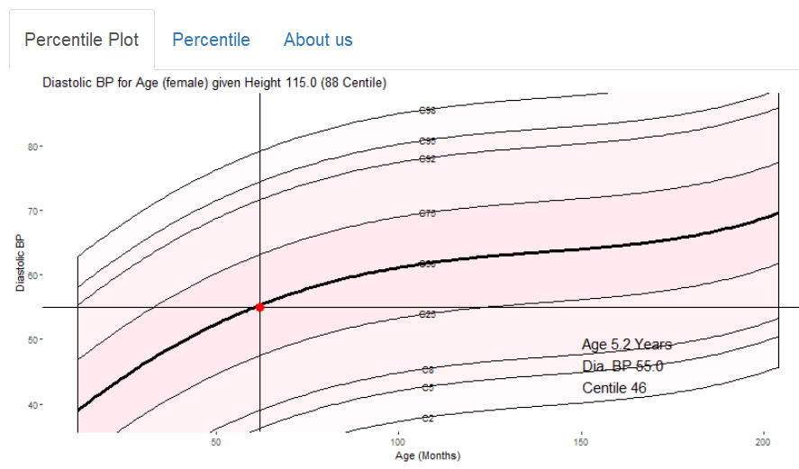
Diastolic bp
After we click the select button of diastolic blood pressure, then click action button, the plot pops out like above. The center of the cross shows the percentile of diatolic blood pressure .

Slide 8
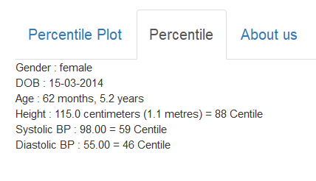
Click the “Percentile” icon, the plot will disappear. The information of Gender, DOB, Age, Height (cm and %), Systolic BP(mmHg and %), Diastolic BP (mmHg and %) will be shown on the dashboard in text format.

Slide 9
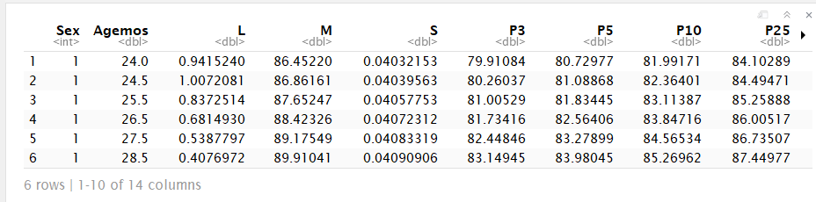
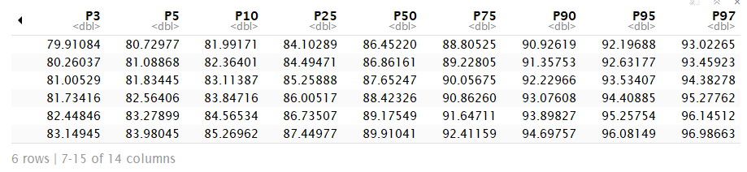
CDC Parameter DATABASE
https://www.cdc.gov/growthcharts/percentile_data_files.htm
Parameters to calculate z_scores of heights
% of heights by sex and age
% of heights by sex and age

Slide 10
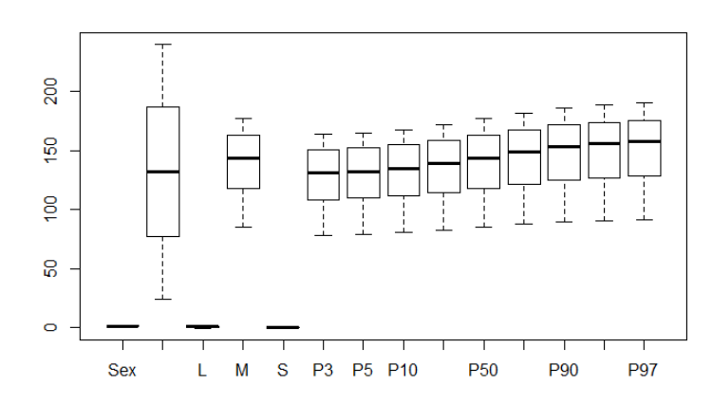
Boxplot of CDC Data: Height in % with L,MS parameter
Age(months)
Height in Percentile (%)
Parameters in association with z_scores of heights

Slide 11
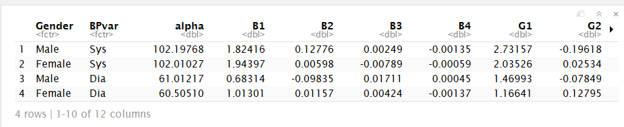
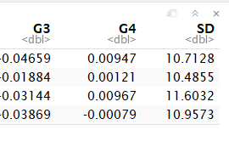
regression coefficients model from blood pressure regression model (JNC-7 )
G1, G2, G3, G4 are z_scores of heights which will link to the CDC parameters (LMS)
Alphas and betas are the parameter to calculate bp centiles.
JNC7: The Seventh Report of the Joint National Committee on Prevention, Detection, Evaluation, and Treatment of High Blood Pressure
The Fourth Report on the Diagnosis, Evaluation, and Treatment of High Blood Pressure in Children and Adolescents. Pediatrics, August 2004, VOLUME 114 / ISSUE Supplement

Slide 12

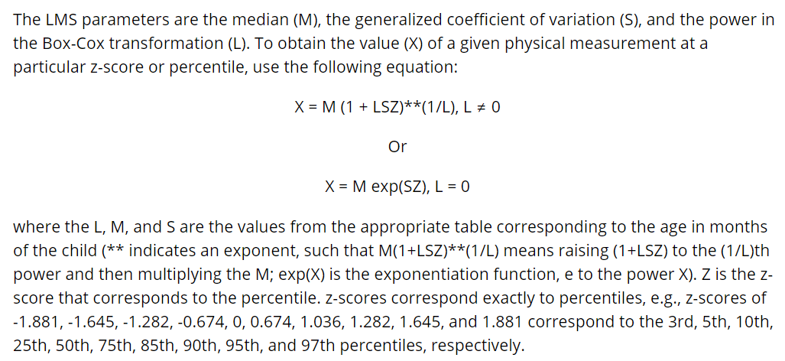
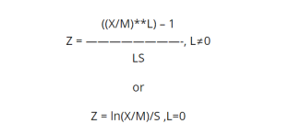
Generate Percentile (2 datasets, 3 formula)
Parameter’s to calculate Percentiles of Height, Sys. Bp, Dia. Bp
Age | Sex | L | M | S | Alpha | Beta | Gamma | SD
CDC
JNC7
Calculate Bps
L,M, S for Height
Percentiles (%)
Height
Systolic Blood Pressure
Diastolic Blood Pressure
Formula for z score

Slide 13
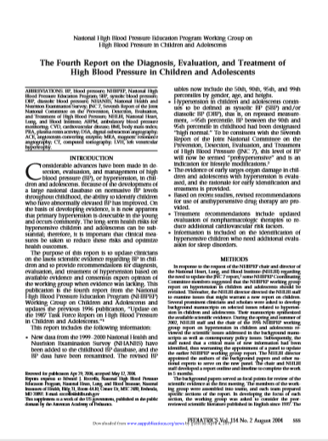
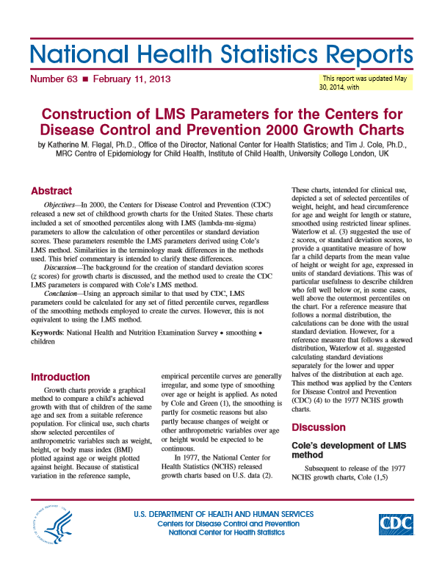
References

Slide 14


